Slide 1
Design and drawing for production
Unit 3 - Lettering
Section 1 – What is Lettering

Slide 2
Google classroom code
okia9n

Slide 3
The big idea
There are different styles of lettering and industry standards
Guidelines are used for height and slope of letters
Single-stroke Gothic letters are commonly used in industry

Slide 4
What is lettering
Purpose is to clarify the views or projections
Notes may specify materials and processes
Most drafters are required to letter drawings freehand
Lettering is about 20% of manual work for any drafter

Slide 5
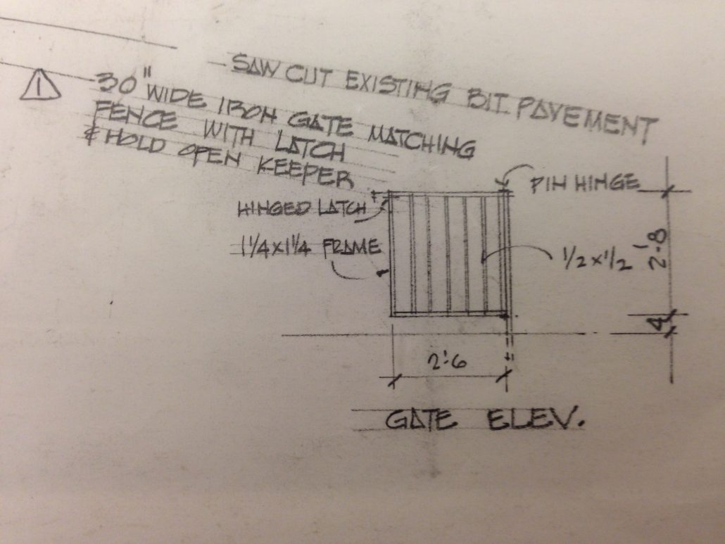
Lettering technique
Use less pressure on your pencil
Having a pencil with a point will help produce high quality lettering that can be copied easily and clearly
Have your forearm fully supported with your hand resting on its side
Take your time and relax, pausing is most likely needed
“Pull” the pencil across the page to not dig into the drawing

Slide 6
Lettering Guide
The Ames Lettering Guide can help provide guidelines for freehand technical drawing

Slide 7
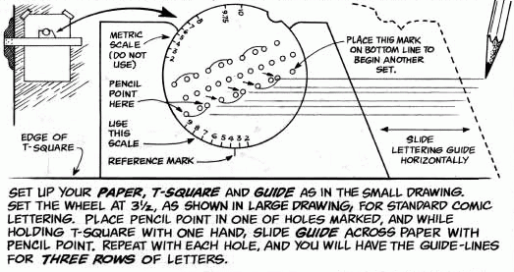

Slide 8

Drawing #5
Using the lettering guide to create your title blocks
3/8” vertical capitals
1/8” vertical capitals
1/8” vertical lower case

Slide 9
Lesson Plan 4

Slide 10
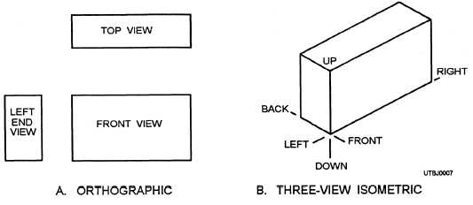
Why technical lettering?
Clarify projections

Slide 11
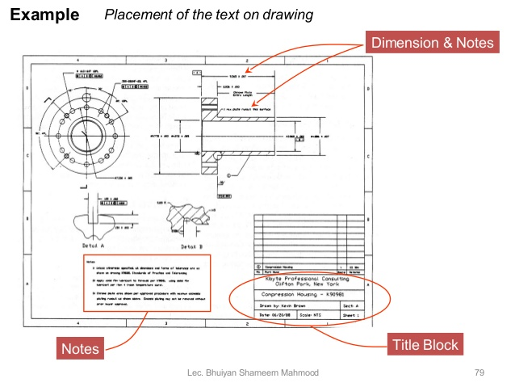
Why technical lettering?
Notes to specify materials and/or processes

Slide 13
Drawing #5
Using the lettering guide to create your title blocks
3/8” vertical capitals
1/8” vertical capitals
1/8” vertical lower case
DUE TUESDAY OCTOBER 9TH

Slide 14
Lesson Plan 5

Slide 15
Do Now
What is the importance of lettering?
Be sure to answer the question within Google Classroom
Answer within the allotted time in class to receive full credit
Answer on the same day to receive half-credit

Slide 16
Lesson Plan 6

Slide 17
This Week in DDP
Drawing #5
DUE TODAY, 10/9 by end of class
2 Lettering practice handouts
DUE FRIDAY 10/12
1 on Wednesday
1 on Thursday
Google Classroom QUIZ
DUE SUNDAY 10/14
To be posted Friday morning

Slide 18
Drawing #5 - Lettering
DUE DATE: TODAY, 10/9 by end of class
TIPS
Good spacing between letters
Watch smudges
Use tools properly

Slide 19
Lesson Plan 7

Slide 20
Rest of the week at a glance
Drawing #5
Was due yesterday, Tuesday, 10/9
Each missed day -10 points
Drawing #6 Handout 4-1
Due tomorrow, Thursday, 10/11
Drawing #7 Handout 4-2
Due Friday, 10/12
Unit 3 Lettering Quiz
Due Sunday
Is to be completed via Google Classroom

Slide 21
Drawing #6 – Lettering Handout 4-1
DUE DATE: TOMORROW, 10/11 by end of class
TIPS
Good spacing between letters
Watch smudges
Use tools properly

Slide 22
Lesson Plan 8

Slide 23
Rest of the week at a glance
Drawing #5
Was due yesterday, Tuesday, 10/9
Each missed day -10 points
Drawing #6 Handout 4-1
Due tomorrow, Thursday, 10/11
Drawing #7 Handout 4-2
Due Friday, 10/12
Unit 3 Lettering Quiz
Due Sunday
Is to be completed via Google Classroom

Slide 24
Lesson Plan 8

Slide 25
UNIT 3 QUIZ NOW AVAILABLE
Be sure to complete via Google Classroom by 11:59PM Sunday

Slide 26
Rest of the week at a glance
Drawing #5
Was due Tuesday, 10/9
Each missed day -10 points
Drawing #6 Handout 4-1
Was due Thursday, 10/11
Each missed day -10 points
Drawing #7 Handout 4-2
Due TODAY, Friday, 10/12
Unit 3 Lettering Quiz
IS NOW OPEN
Due Sunday at 11:59PM

